Slide 1
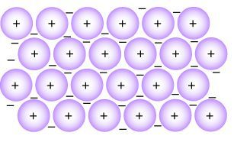
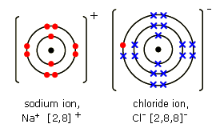

Y9 Recap
Types of Bonding
9C3
Metallic Bonding
Metal
Electrons are delocalised
Ionic Bonding
Metal + non-metal
Electrons are transferred
Covalent Bonding
Non-metals
Electrons are shared

Slide 2
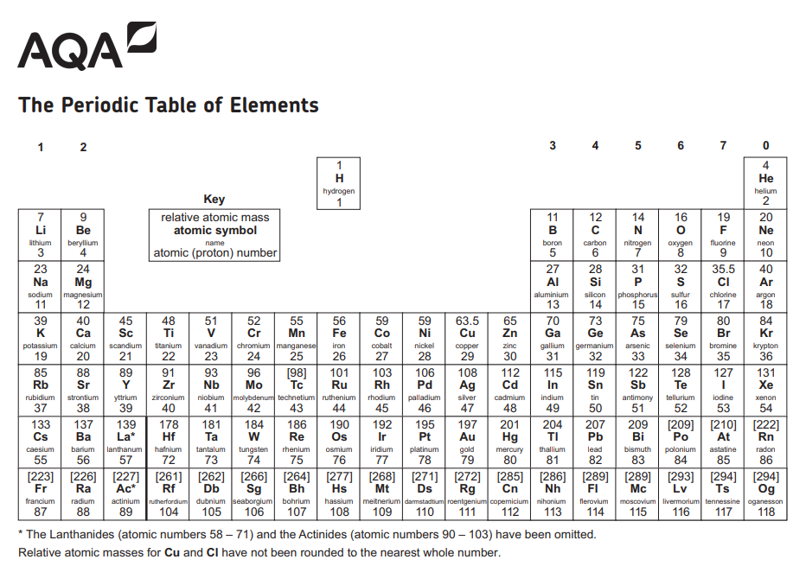

Slide 3
Y9 Recap
Types of Bonding
9C3
Identify the type of bonding in these substances:
NaCl
Li
H₂O
MgO
Na
Na₂O
LiCl
O₂
H₂O₂
Cu
K₂O
H₂
CuSO₄
CO
NH₃

Slide 4
Y9 Recap
Types of Bonding
9C3
NaCl ionic bonding
Li metallic bonding
H₂O covalent bonding
MgO ionic bonding
Na metallic bonding
Na₂O ionic bonding
LiCl ionic bonding
O₂ covalent bonding
H₂O₂ covalent bonding
Cu metallic bonding
K₂O ionic bonding
H₂ covalent bonding
CuSO₄ ionic bonding
CO covalent bonding
NH₃ covalent bonding

Slide 5
Application
Bonding Fact File
C2
Ionic Bonding | Ionic Bonding
 | Between metal + non-metal e.g. NaCl, Na₂O
Structure | Giant ionic lattice
Bonding | Strong ionic bonds
Properties | High melting points and boiling points Strong ionic bonds, lots of energy needed to break these Conduct electricity when molten or in solution Ions are mobile and can carry the charge

Slide 6
Application
Bonding Fact File
C2
Covalent bonding: small molecules | Ionic Bonding
 | Between non-metals e.g. H₂O, NH₃, CH₄
Structure | Small molecule
Bonding | Strong covalent bonds. Weak intermolecular forces between the molecules.
Properties | Low melting points and boiling points Strong covalent bonds. Weak intermolecular forces, not much energy is needed to break these. Do not conduct electricity ever No charged particles.

Slide 7
Application
Bonding Fact File
C2
Covalent bonding: large molecules (polymers) | Ionic Bonding
 | Between non-metals, large molecules e.g. polymers (hydrocarbons)
Structure | Large molecule
Bonding | Strong covalent bonds. Relatively strong intermolecular forces between the molecules.
Properties | Solid at room temperature Strong covalent bonds. Relatively strong intermolecular forces, not much energy is needed to break these. Do not conduct electricity ever No charged particles.

Slide 8
Application
Bonding Fact File
C2
Covalent bonding: Giant covalent compounds | Ionic Bonding
 | Between non-metals e.g. silicon dioxide, diamond, graphite
Structure | Giant covalent structure
Bonding | Only strong covalent bonds between atoms. No weak intermolecular forces.
Properties | Very high melting and boiling points Lots of strong covalent bonds that require a lot of energy to break them. Do not conduct electricity (one exception: graphite) No charged particles.

Slide 9
Application
Bonding Fact File
C2
Covalent bonding: Giant covalent compounds | Ionic Bonding
 | Diamond | Graphite | Graphene
Structure | Giant covalent | Giant covalent | Giant covalent
Bonding | Covalent Each C bonds to 4 other C atoms | Covalent Each C bonds to 3 other C atoms | Covalent Each C bonds to 3 other C atoms
Properties | Very hard Only strong covalent bonds Very high melting point Only strong covalent bonds and lots of energy needed to make these Does not conduct electricity No free electrons, no mobile ions | Conducts electricity. one delocalised electron from each C atom, it is free to move between layers Layers can slide so it is a good lubricant. Weak intermolecular forces between the layers, these are easily broken, | High melting point Only strong covalent bonds Conducts electricity one delocalised electron from each C atom, it is free to move Very strong Only strong covalent bonds

Slide 10
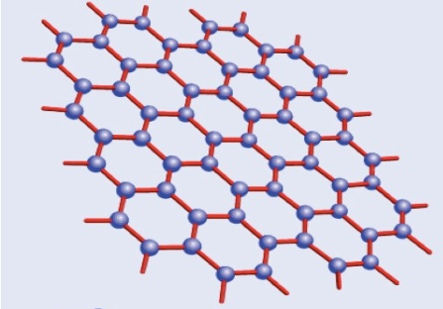

Teacher Input
Graphene, Fullerenes and Nanotubes
C2
 | Graphene | Fullerene | Nanotube
Structure | Giant covalent One layer of graphite | Giant covalent A hollow cage of carbon atoms | Giant covalent A hollow tube of carbon atoms
Bonding | Covalent | Covalent | Covalent
Uses | Electronics: very effective conductor of electricity due to free electrons Very strong so useful in advanced materials (composites) | Drug delivery for medical applications Lubricants (weak forces between cages so easy for cages to slip over each other) Catalysts | High tensile strength so can be used in composite materials e.g., tennis rackets Electronics due to high electrical conductivity

Slide 11
Application
Bonding Fact File
C2
Covalent bonding: Giant Metallic Lattice | Ionic Bonding
 | In metals e.g. copper, iron, sodium, magnesium
Structure | Giant metallic structure
Bonding | Strong metallic bonds. Positive metal ions surrounded by delocalised electrons.
Properties | High melting and boiling points Lots of strong metallic bonds that require a lot of energy to break them. Conduct electricity Delocalised electrons are free to carry the charge through the whole structure Conduct heat Delocalised electrons transfer energy Malleable Layers of ions can slide over each other

